Slide 1
Projectile motion with drag
USTH final project

Slide 2
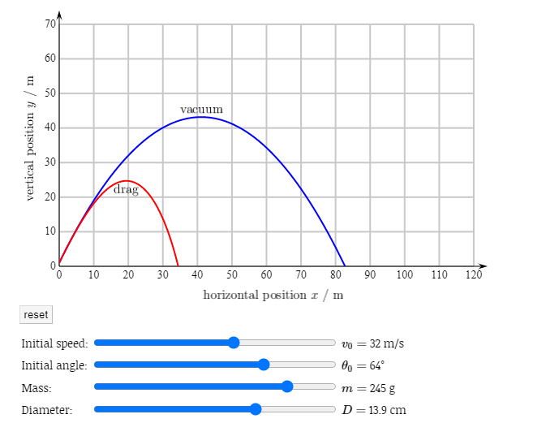

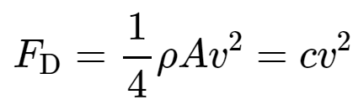
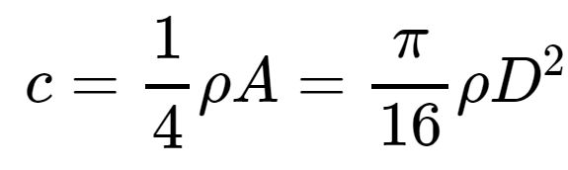
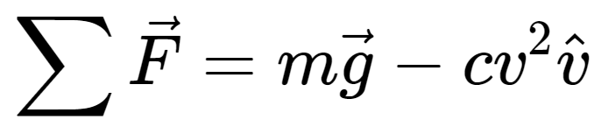
Physics background of Projectile motion with drag
The drag force is always directly opposed to the velocity of the object. In vector notation,
Quadratic drag model

Slide 3
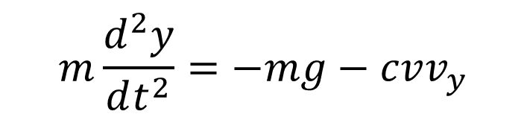

The projectile motion is influenced by force of gravity and drag force due to air resistance.
$$m\frac{d^{2}x}{dt^{2}}=−cvv_{x}$$
$$m\frac{d^{2}y}{dt^{2}}=−mg−cvv_{y}$$

Slide 4
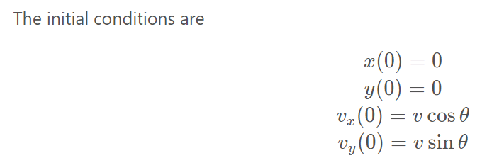
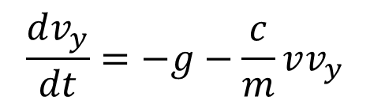
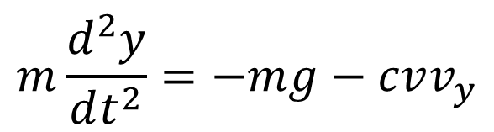

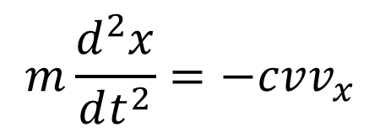
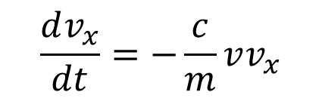

For numerically solving the differential equations, let us split them into two first order differential equations.
$$\frac{dx}{dt}=v_{x}$$
$$m\frac{d^{2}x}{dt^{2}}=−cvv_{x}$$
$$\frac{dv_{x}}{dt}=−\frac{c}{m}vv_{x}$$
$$\frac{dy}{dt}=v_{y}$$
$$m\frac{d^{2}y}{dt^{2}}=−mg−cvv_{y}$$
$$\frac{dv_{y}}{dt}=−g−\frac{c}{m}vv_{y}$$

Slide 5
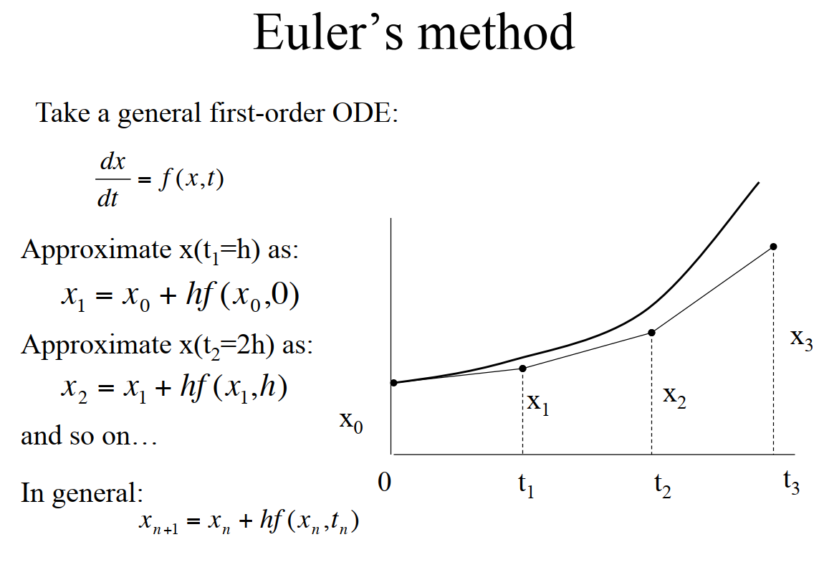

Slide 6
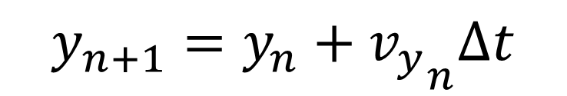
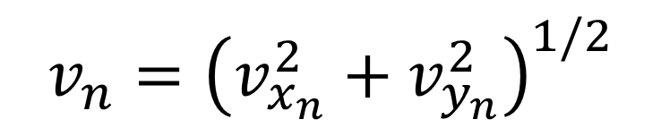
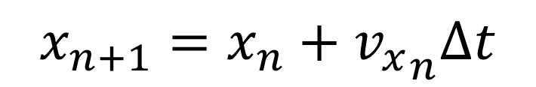

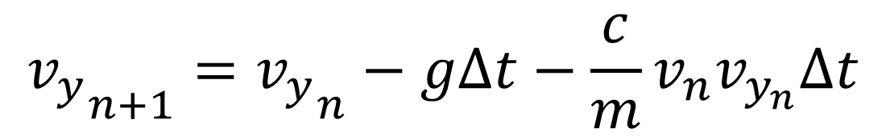
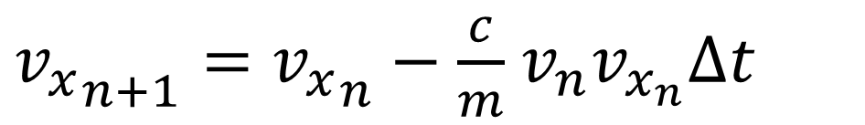
$$x_{n+1}=x_{n}+{v_{x}}_{n}Δt$$
$$y_{n+1}=y_{n}+{v_{y}}_{n}Δt$$
$$t_{n+1}=t_{n}+Δt$$
$$v_{n}={\left(v_{x_{n}}^{2}+v_{y_{n}}^{2}\right)}^{1/2}$$
${v_{x}}_{n+1}={v_{x}}_{n}−\frac{c}{m}$ $v_{n}v_{x_{n}}Δt$
$${v_{y}}_{n+1}={v_{y}}_{n}−gΔt−\frac{c}{m}v_{n}v_{y_{n}}Δt$$

Slide 7
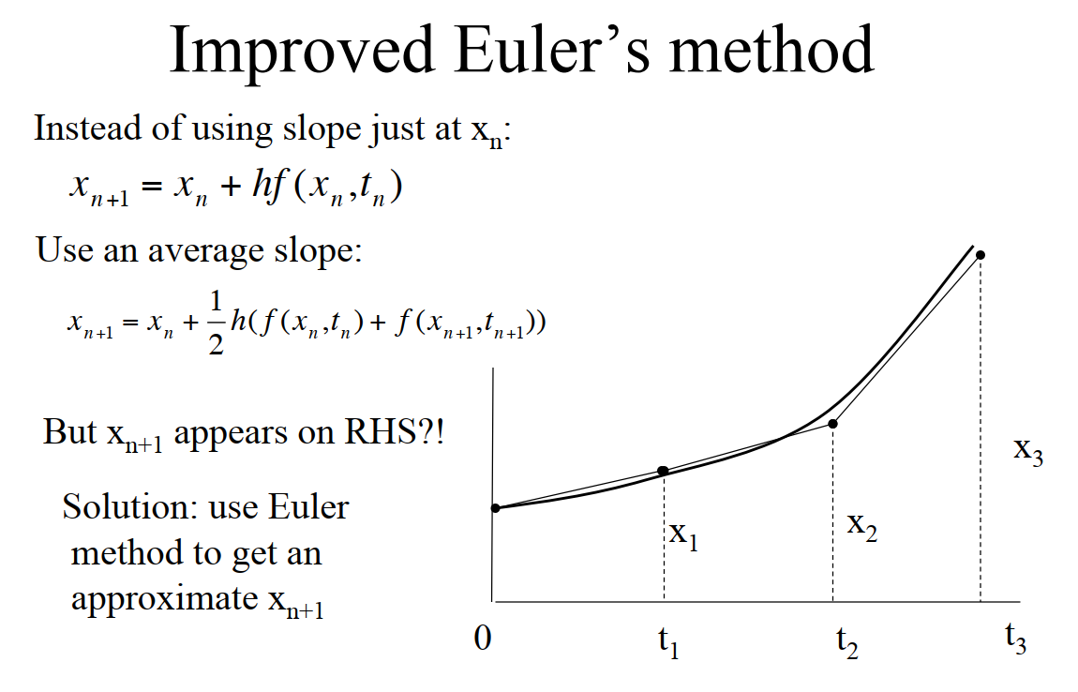

Slide 8
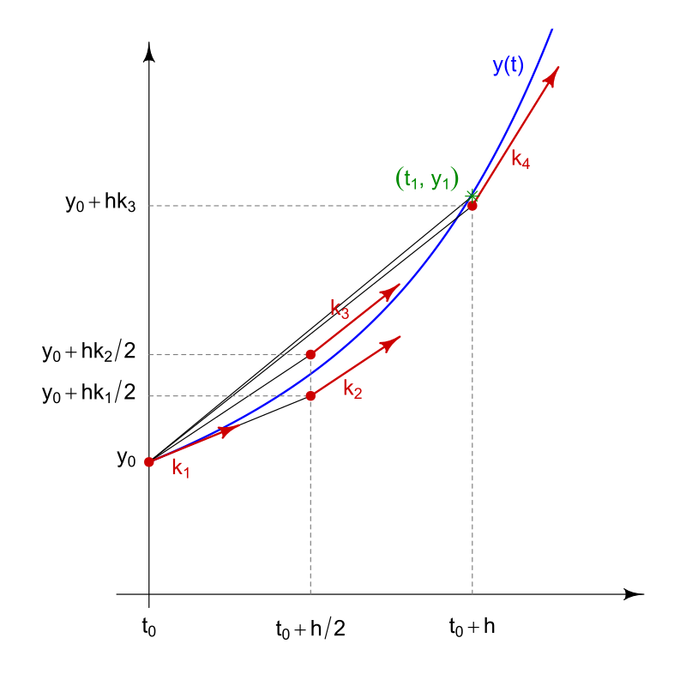

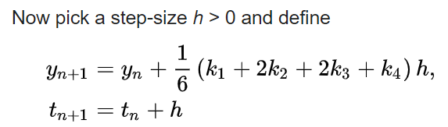
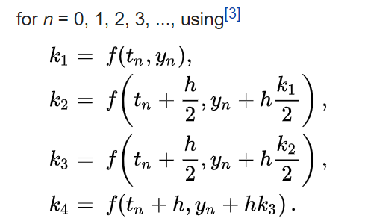
Runge-Kutta method

